Slide 1

Azure App Services

Slide 2
AppServices Overview
Azure App Service is an HTTP-based service for hosting web applications, REST APIs, and mobile back ends. You can develop in your favorite language, be it .NET, .NET Core, Java, Node.js, PHP, and Python. Applications run and scale with ease on both Windows and Linux-based environments.
App Service adds the power of Microsoft Azure to your application, such as security, load balancing, autoscaling, and automated management.
Additionally, you can take advantage of its DevOps capabilities, such as continuous deployment from Azure DevOps, GitHub, Docker Hub, and other sources, package management, staging environments, custom domain, and TLS/SSL certificates.

Slide 3
What is Azure App Service
Azure App Service is a fully managed Platform as a Service (PaaS) that provides you with the tools and services needed to create reliable and scalable mission-critical Web Apps, Mobile Apps, API Apps, and Logic Apps in a single instance.
It takes away your management of the host and lets you focus entirely on building your application for performance.

Slide 4
Why use App Service?
Azure App Service is a fully managed platform as a service (PaaS) offering for developers. Here are some key features of App Service:
Multiple languages and frameworks - App Service has first-class support for ASP.NET, ASP.NET Core, Java, Ruby, Node.js, PHP, or Python. You can also run PowerShell and other scripts or executables as background services.
Managed production environment - App Service automatically patches and maintains the OS and language frameworks for you. Spend time writing great apps and let Azure worry about the platform.
Containerization and Docker - Dockerize your app and host a custom Windows or Linux container in App Service. Run multi-container apps with Docker Compose. Migrate your Docker skills directly to App Service.
DevOps optimization - Set up continuous integration and deployment with Azure DevOps, GitHub, BitBucket, Docker Hub, or Azure Container Registry. Promote updates through test and staging environments. Manage your apps in App Service by using Azure PowerShell or the cross-platform command-line interface (CLI).
Global scale with high availability - Scale up or out manually or automatically. Host your apps anywhere in Microsoft's global datacenter infrastructure, and the App Service SLA promises high availability.

Slide 5
Why use App Service?
Connections to SaaS platforms and on-premises data - Choose from many hundreds of connectors for enterprise systems (such as SAP), SaaS services (such as Salesforce), and internet services (such as Facebook). Access on-premises data using Hybrid Connections and Azure Virtual Networks.
Security and compliance - App Service is ISO, SOC, and PCI compliant. Create IP address restrictions and managed service identities. Prevent subdomain takeovers.
Authentication - Authenticate users using the built-in authentication component. Authenticate users with Azure Active Directory, Google, Facebook, Twitter, or Microsoft account.
Application templates - Choose from an extensive list of application templates in the Azure Marketplace, such as WordPress, Joomla, and Drupal.
Visual Studio and Visual Studio Code integration - Dedicated tools in Visual Studio and Visual Studio Code streamline the work of creating, deploying, and debugging.
API and mobile features - App Service provides turn-key CORS support for RESTful API scenarios, and simplifies mobile app scenarios by enabling authentication, offline data sync, push notifications, and more.
Serverless code - Run a code snippet or script on-demand without having to explicitly provision or manage infrastructure, and pay only for the compute time your code actually uses .

Slide 6
What is App Service Plan
To create App Service, you need an App Service Plan. Without an App Service Plan you cannot create App Service. So, in the Azure portal, when you try to create app service, you will have to select an app service plan if you have one already or create a new one. The point is, without an App Service Plan, you cannot create App Service. This is beacuse it is the App Service Plan that defines the compute resources required for your application to run.

Slide 7
How to Create App Services in Azure Portal
Step 1: Prerequisites
a) You should have a valid Azure Account.
b) You should have a valid subscription.
c) You should have access to create an App Service.
Step 2: Login to Azure Portal
First you need login to below Azure Portal using your valid user account and password.
Upon successful login, you will land into Portal Home Page from where you can create all the required resources.

Slide 8
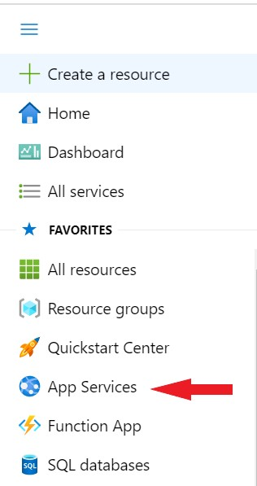
Step 3: Create a Resource Group
All the resources which you are going to create, it should be created in a Resource Group. So the next step is to create a Resource Group.
Step 4: Open App Services
In the next step you need to create an app service from Azure App Services. You can either search App Services from the Home Page search box or go directly to the Service from Portal Menu as you can see below.

Slide 9
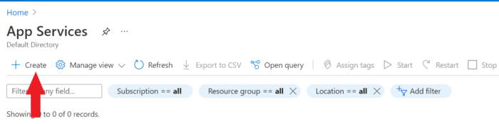
Step 5: Create App Service
Once App Services opened, you can click on Create as shown below.

Slide 10
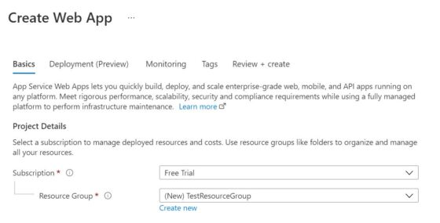
a) Basics
You will see below Create Web App window where you need to first fill the Basics section. You need to select your Subscription and Resource Group which you want to use.

Slide 11
Then you need to provide the Instance details were you need to provide a unique instance name. I am using test301 so the complete name becomes test301.azurewebsites.net as you can see below.
Then you have the option to publish it as Code or Docker Container.
I will choose to publish as Code. Next you need to choose the Runtime Stack.
I am using .NET 6(Early Access) as my runtime stack. You can choose as per your requirement.
Then you need to choose the Operating System you want to use. Currently Azure provides two options - Linux or Windows.
I am going to choose Windows for my web app. Finally, you need to choose the Region. By default, Central US will be selected.
I will use this default option however you can change it to a suitable location as per your need.

Slide 12
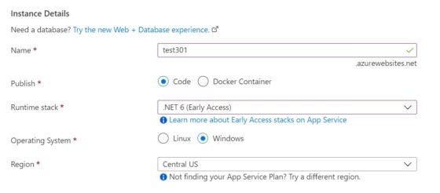

Slide 13
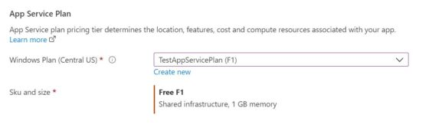
If you further scroll down, you will see App Service Plan details to fill. You can either use any existing App Service Plan or create a new one by Clicking on Create new.
b) Deployment(Preview)
In the next section, you need to select your Deployment settings.
This option is pretty handy if you are looking to perform Continuous deployment of your web app in App Service.
You can set up GitHub repository to maintain your project source codes and can deploy your web app to App Service based on new commit done on repository.

Slide 14
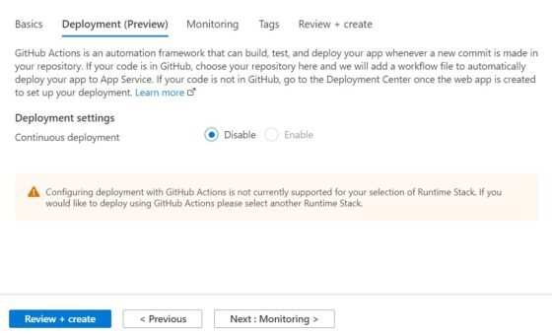

Slide 15
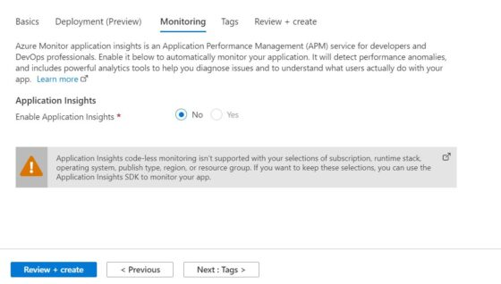
c) Monitoring
Next section is about enabling the monitoring for this app service using Application Insights. Azure has a very powerful Application Performance Management(APM) tool called Application Insights which can be used to monitor Azure resources for any performance anomalies. For the moment, I am keeping it disabled by clicking on No as you can see below. Then Click on Next: Tags to proceed.

Slide 16
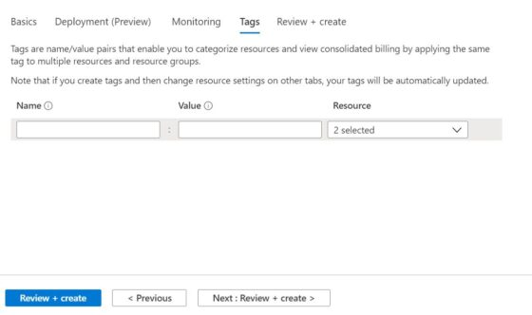
d) Tags
Here you can use the Tags to categorize your resources which further helps you in tracking the billing of those resources. Each of the tags that you create are just name/value pairs. Since here I am not using any tags so I will just click on Next: Review + create> to proceed to the next section.

Slide 17
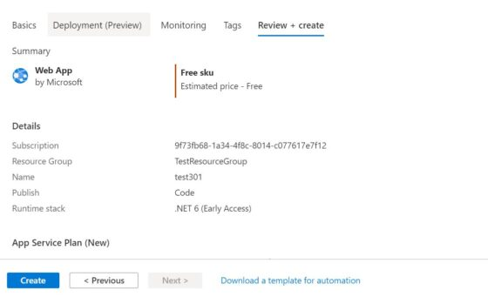
e) Review+Create
Finally, you can review all your configuration and then click on Create once you verified all the details given in each section.

Slide 18
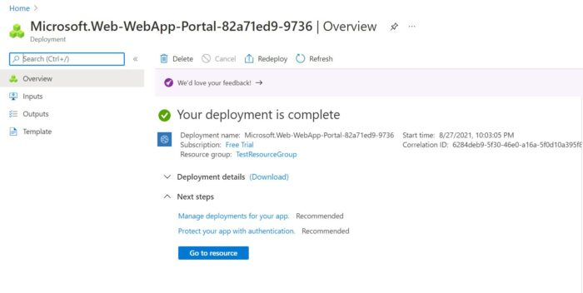
After a while you can see that your deployment is completed and it should look like below. You can get more details about this deployment by clicking on Go to resource . This completes the creation of web app Services.

